Slide 1
Interference between I/O and MPI Traffic on Fat-tree Networks
Brown, Kevin A., et al.
Proceedings of the 47th International Conference on Parallel Processing. 2018.
Cloud Computing
221025 Sohee Kim
Notes:
Brown, Kevin A., et al. "Interference between I/O and MPI traffic on fat-tree networks." Proceedings of the 47th International Conference on Parallel Processing. 2018.
https://dl.acm.org/doi/pdf/10.1145/3225058.3225144

Slide 2
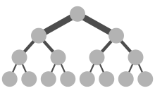
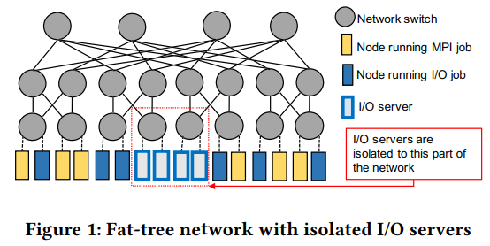
1. Introduction
Brown, Kevin A., et al. "Interference between I/O and MPI traffic on fat-tree networks." Proceedings of the 47th International Conference on Parallel Processing. 2018.
https://en.wikipedia.org/wiki/Fat_tree
High performance computing (HPC) workloads
Data movement – significant performance degradation for many applications
Off-node data movement : MPI or I/O
This paper characterizes the effects of interference between MPI and I/O traffic on the performance of each of these traffic types
Two main challenges
Programmers must manually partition their computation to fit within the lambda function time limit
Programmers have no concurrency or synchronization primitives at their disposal, and so must either implement such primitives, restrict themselves to use share-nothing parallelism, or eschew the use of parallel lambdas
https://buildgoodhabit.tistory.com/73
Notes:
Many production high performance computing (HPC) workloads involve significant data exchange among compute nodes as well as between compute nodes and parallel file systems.
Data movement is necessitated because simulation data can rarely fit on a single compute node, and due to file input/output requirements of computational simulations.
Past research has shown that such data movement on HPC systems is a source of significant performance degradation for many applications.
Studies have also shown that off-node data movement is particularly susceptible to interference on systems where the network infrastructure is shared by all running jobs [5, 25]. However, with the exception of Mubarak et al. [17], these studies have focused on network traffic generated by one of the two major sources of off-node data movement: MPI or I/O
In order to develop a better understanding of the aforementioned topics, this paper characterizes the effects of interference between MPI and I/O traffic on the performance of each of these traffic types. Our characterization explores several factors that may impact the interference, including message sizes, communication intervals, system allocations, and task placement
We focus on the fat-tree topology
CODES simulation framework

Slide 3
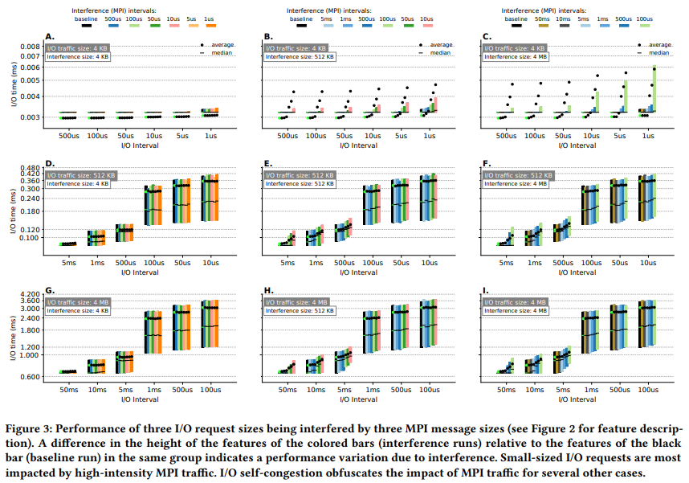
2. Characterization of interference
Brown, Kevin A., et al. "Interference between I/O and MPI traffic on fat-tree networks." Proceedings of the 47th International Conference on Parallel Processing. 2018.
I/O job
The latency of small I/O requests is sensitive to high-intensity MPI interference
4 KB
Not affected
increase
The increase is not due to the presence of MPI traffic
512 KB
No interference
I/O-congestion threshold
4 MB
an increase in the MPI traffic intensity causes a corresponding increase in the I/O request times
4 KB
512 KB
4 MB
Notes:
- Graph I
an increase in the MPI traffic intensity causes a corresponding increase in the I/O request times before the I/O-congestion threshold is reached.
Once we cross the I/O-congestion threshold at 1 ms I/O intervals, the interfering MPI traffic does not show a significant impact on I/O performance.

Slide 4
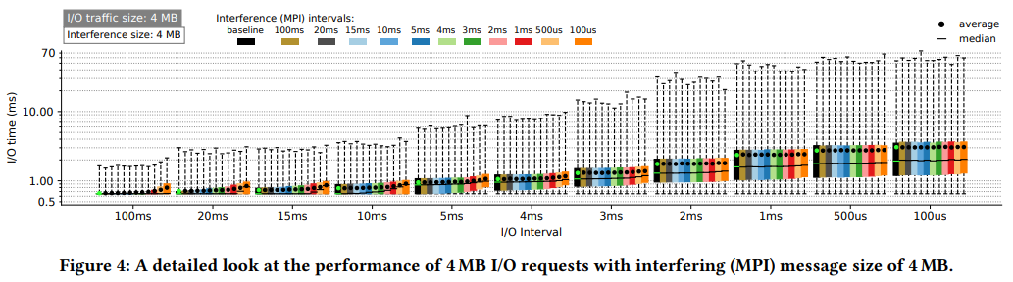
2. Characterization of interference
Brown, Kevin A., et al. "Interference between I/O and MPI traffic on fat-tree networks." Proceedings of the 47th International Conference on Parallel Processing. 2018.
I/O job
Notes:
- Graph I
an increase in the MPI traffic intensity causes a corresponding increase in the I/O request times before the I/O-congestion threshold is reached.
Once we cross the I/O-congestion threshold at 1 ms I/O intervals, the interfering MPI traffic does not show a significant impact on I/O performance.

Slide 5
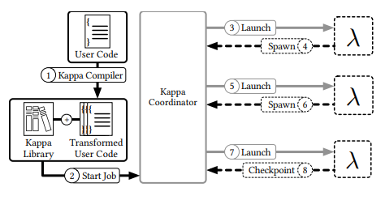
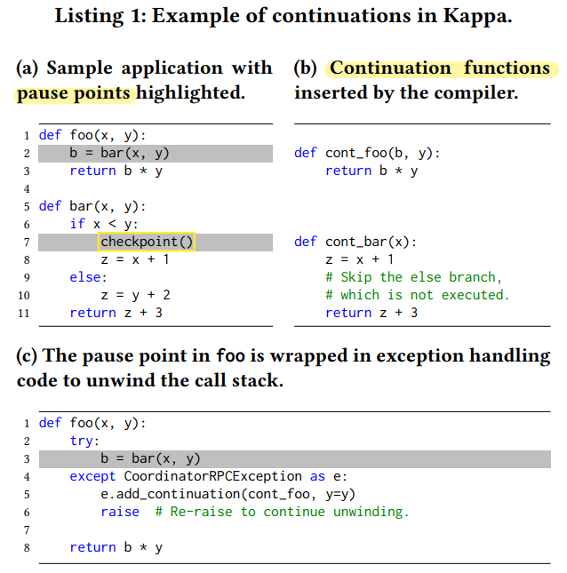
2. Kappa Design
Zhang, Wen, et al. "Kappa: A programming framework for serverless computing." Proceedings of the 11th ACM Symposium on Cloud Computing. 2020.
Checkpointing
Example of continuations
Checkpoints – implemented using continuations
A well understood technique for suspending and resuming execution
A closure that captures program state and control flow information at some execution point
Pause points
Takes a checkpoint by generating a continuation and serializing it to storage
Restores from a checkpoint by deserializing and invoking a previously stored continuation
Checkpoint (list)
Function name
Live variables
Hole
- Previous continuation’s result
Notes:
As mentioned before, Kappa uses checkpoints to tolerate lambda function timeouts and to prevent RPC duplication.
Checkpoints in Kappa are implemented using continuations [74], a language-level mechanism executed in user mode. Continuations are a well understood technique for suspending and resuming execution, and have been used in past systems for checkpointing and fault tolerance [79, 88], task migration [28, 78, 79, 88], asynchronous calls [51, 54], context switching [86], and debugging [16]. Kappa’s checkpointing technique is nearly identical to that of previous systems, although there might be implementation differences.
A continuation can be thought of as a closure that captures program state and control flow information at some execution point; calling the closure resumes execution from this point in the program.
Kappa takes a checkpoint by generating a continuation and serializing it to storage, and restores from a checkpoint by deserializing and invoking a previously stored continuation.
This list is an example of continuations. I will explain how continuations are generated for the checkpoint() call on line 7. The code is first transformed by the Kappa compiler, which identifies all the pause points in the code, which is highlighted. There are 2 pause points.
For each, the compiler generates a continuation function definition and inserts it into the source code.
As shown in B, a continuation function contains all the code that executes after the corresponding pause point, and takes a arguments any variable whose value is accessed by the subsequent code (called live variables)
Finally, consider the function call foo(3,4) at execution time. The checkpoint taken by bar can be written as a list consisting of one continuation per frame on the call stack: [(cont_bar, x = 3), (cont_foo, b = □, y = 4)] ,
where a continuation is a tuple of (1) its continuation function’s name and (2) live variables in that frame; “□” denotes a hole to be filled in with the previous continuation’s result.
To resume from this checkpoint, the Kappa library invokes the continuations in order (e.g., cont_bar(x=3)), substituting each continuation’s return value into its successor’s hole. The return value of the topmost function—i.e., the task’s final result—is reported to the coordinator.

Slide 6
5. Limitations, Conclusion
Zhang, Wen, et al. "Kappa: A programming framework for serverless computing." Proceedings of the 11th ACM Symposium on Cloud Computing. 2020.
Limitations
Unsupported Python features
not yet added support for some Python features (try/except, yield, async/await, nested function definitions, global variables) to the compiler’s continuation generation logic
Other restrictions on input code
The programmer must: Insert checkpoint(), Mark calls that have externally visible side-effects with @on_coordinator, Use Kappa’s concurrency primitive instead of primitives such as Python threads
Static pause points
Restricts where checkpoints can be generated and precludes deciding checkpoint locations at runtime
Can only checkpoint in transformed code
Checkpoint only in code transformed by the its compiler and not in a Python C extension like numpy
Kappa is a framework that simplifies serverless development by providing a familiar programming model.
By reducing the friction of developing serverless programs, Kappa provides an avenue for a larger set of applications to take advantage of the benefits of serverless computing.
Notes:
While Kappa already supports a wide range of applications, it has a few limitations :
First, They have not yet added support for some Python features to the compiler’s continuation generation logic
Beyond the aforementioned restrictions on Python features, Kappa requires minor modifications to application code.
The programmer must: Insert checkpoint() calls at appropriate points in the program, Mark calls that have externally visible side-effects (e.g., resulting in I/O) with @on_coordinator, and Use Kappa’s concurrency primitives (§ 3.3) instead of primitives such as Python threads.
Kappa identifies pause points statically, and this approach reduces the runtime overhead of checkpointing, but restricts where checkpoints can be generated and precludes deciding checkpoint locations at runtime. Relaxing this limitation through dynamic continuation computation is left to future work.
Kappa can checkpoint only in code transformed by the its compiler and not in, e.g., a Python C extension like numpy.
Python’s dynamic nature makes it challenging to statically analyze application code
Although serverless computing originally targeted event handling, recent efforts such as ExCamera [27] and PyWren [40] have enabled the use of serverless for more diverse applications. However, developing serverless applications still requires significant effort. Kappa is a framework that simplifies serverless development by providing a familiar programming model. By reducing the friction of developing serverless programs, Kappa provides an avenue for a larger set of applications to take advantage of the benefits of serverless computing.

Slide 7
Thank You ☺

